Slide 1
IPL Match Winner Predictor Using Machine Learning

Slide 2
Do you know IPL is the 2nd most viewed league in the world , Only after the esteemed ICC cricket world cup, which happens every 4 years.
"ICC Cricket World Cup 2019 watched by 509M viewers, IPL by 424M on Star Sports: BARC“
https://www.exchange4media.com/industry-briefing-news/icc-cricket-world-cup-2019-watched-by-509m-viewers-ipl-by-424m-on-star-sports-barc-103679.html

Slide 3
Do you know IPL is most followed premier league in the world in cricket, ofcourse.
https://www.sportekz.com/list/popular-t20-cricket-leagues/

Slide 4
Motivation
IPL matches produce a lot of enthusiasm and often go right down to the last ball, if still not enough to decide a winner, The match goes into a super over
What if it is possible to find the winner before the Toss accurately? There is nothing impossible in this world.
Using the past to predict the future, Great , right.
Let us see How?
let us see some interesting analysis first

Slide 5
THE POWER OF DATA SCIENCE

Slide 6
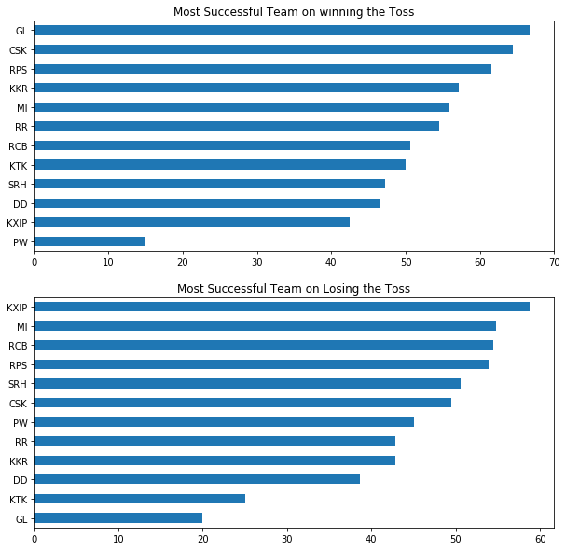
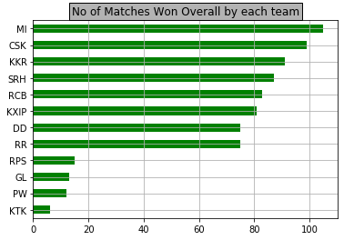
Who is most team Successful all though the IPL?
Who is most Successful when they win or lose the toss?

Slide 7
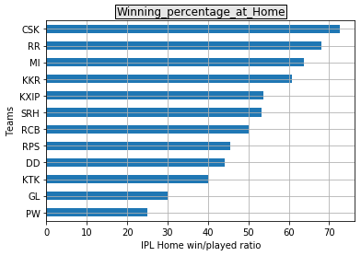
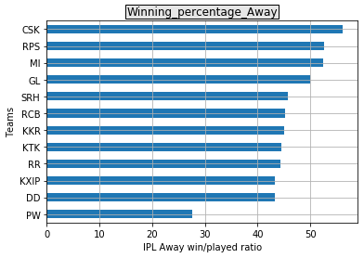
Home/Away Performances

Slide 8
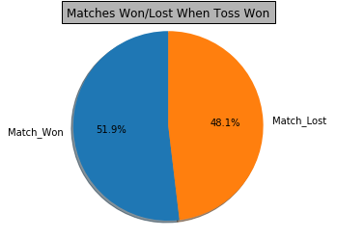
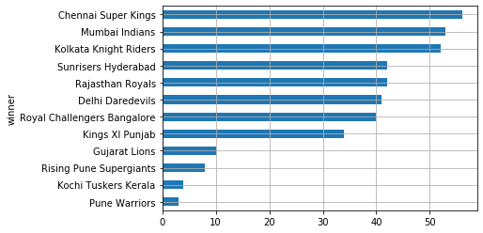
IS toss the Boss?(decides who will win)

Slide 9
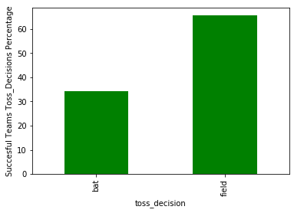
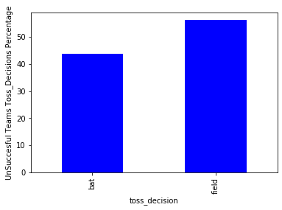
Does Toss Decision matter?
As clearly it shows, it is evident from the both the graphs above that, Toss Decision also does not have much effect on deciding the winner. Fielding teams tends to win or lose most of the matches.

Slide 10
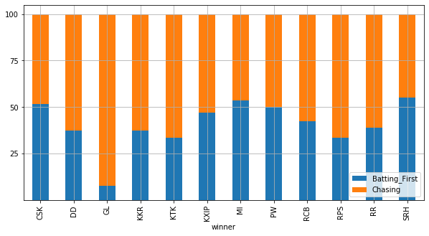
Which is the TEAM to be Beat Batting First Or Chasing ?
While there is no clear team
we can see while batting first(CSK,MI,SRH)
GL is the Team to the beat when chasing

Slide 11
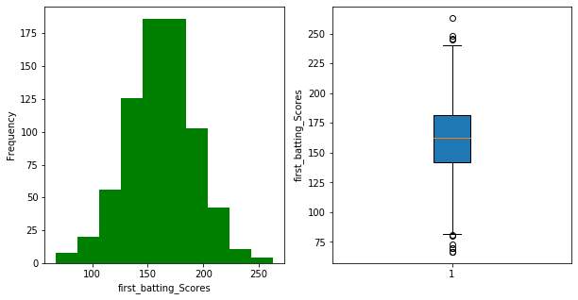
First Innings Scores
count | 742
mean | 161.5458
std | 30.10571
min | 67
25% | 142
50% | 163
75% | 182
max | 263
Follows a Normal Distribution

Slide 12
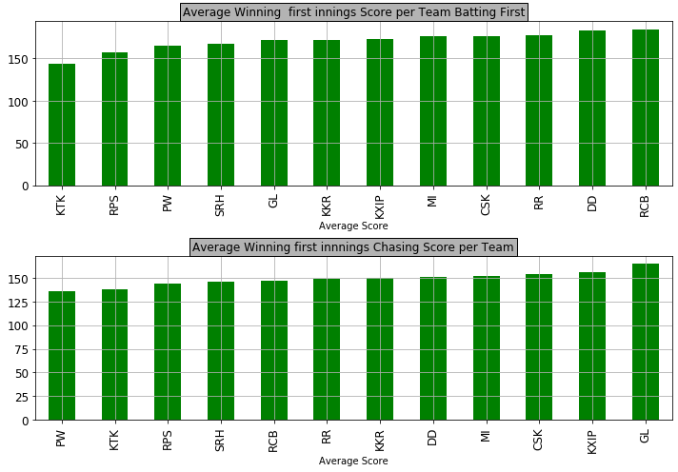
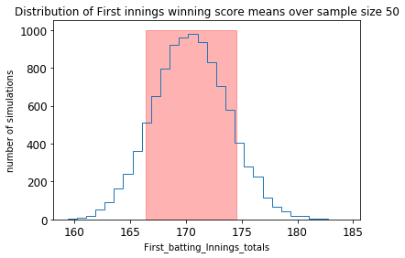
Lets See , What is an Ideal First Innings Winning Score
Shows the Confidence Interval(166.43, 174.53) first innings score for winning a match
RCB has to score the maximum runs 185 to be able defend successfully,
While GL has to restrict to side to at least below 165 to able to chase that score

Slide 13
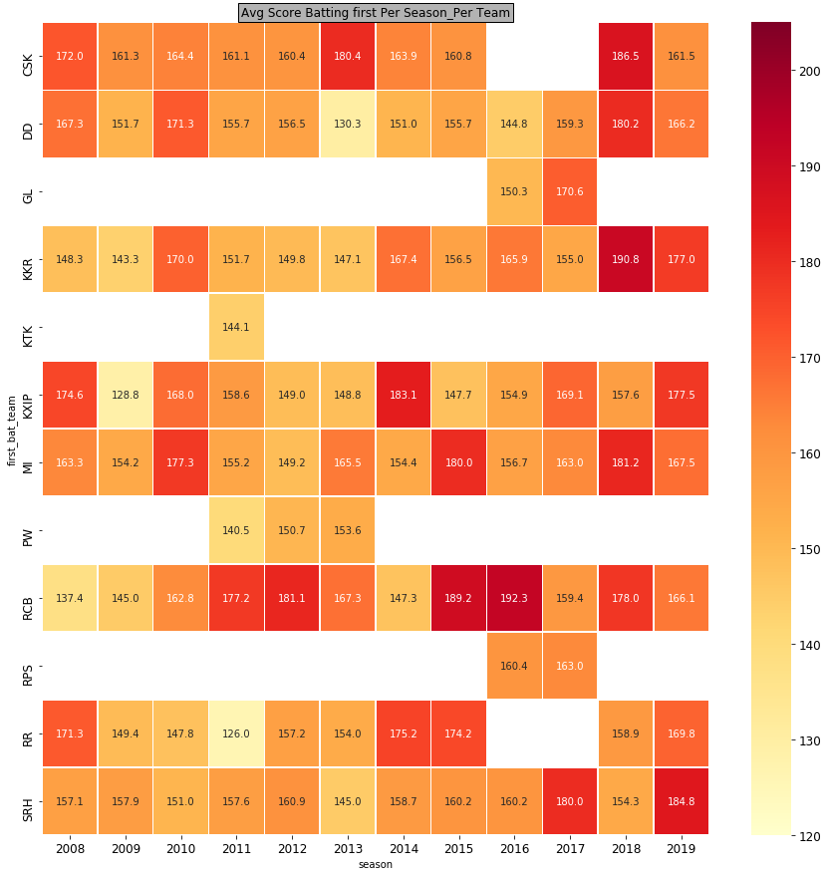
The Heat MAP Inference
12 Teams & 12 Seasons
CSK and RR have missed 2 seasons 2016,17 due to the Spot Fixing Scandals.
GL and RPS played in placed of CSK and RR in 2016,17 IPL seasons
KTK has played just one season
PW franchise was there for 3 years only
RCB tend to have the highest first innings scores over the IPL, due to the ground having shorter boundaries
CSK again the most consistent team with 160+ average totals in every season of the IPL

Slide 14
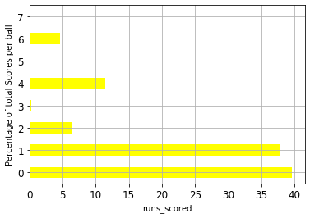
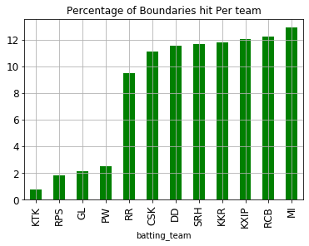
Do you know every 6th ball is hit for a boundary in IPL
Only Approx. 16% of the Total balls have been hit for a Boundary
And Out of these 16%(2% of the Total Boundaries are scored by MI)
And MI has won 4 IPL titles, May be their boundary hitting capabilities are helping them win more titles

